Slide 1
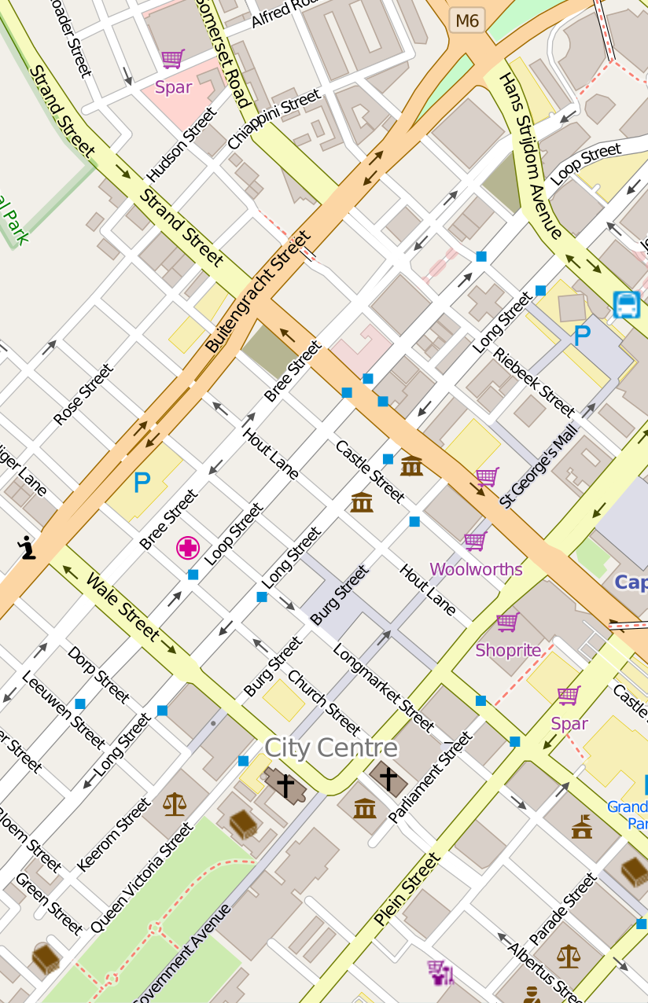


PARCC
We got your spot

Slide 2

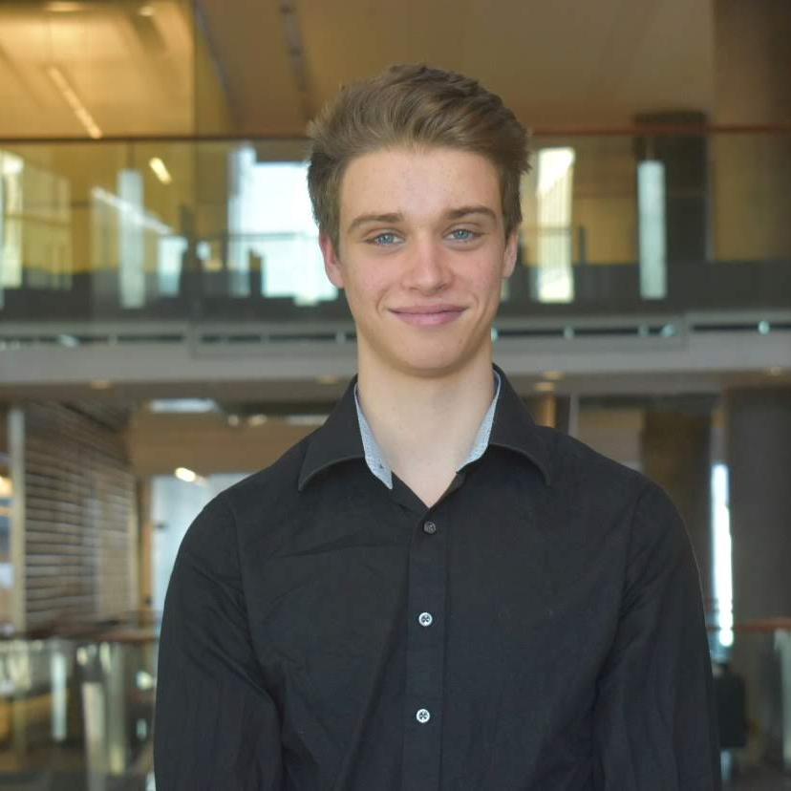


David Murga
Computer Engineering
B.Eng
Cameron Macdonald
Chemical & Biomedical
B.Eng.BME
About Us
We are3 engineering students spanning 4 different disciplines
Ryan Tong
Chemical & Bioengineering
B.Eng
Your company name

Slide 3
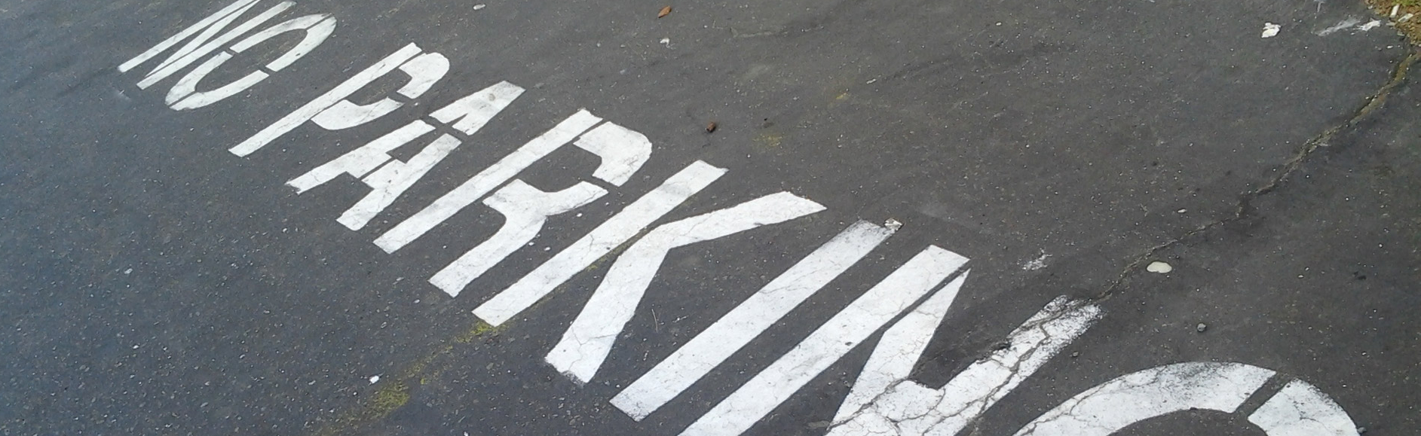
Problem definition
Difficult and stressful finding parking
Hard to understand parking restrictions

Slide 4
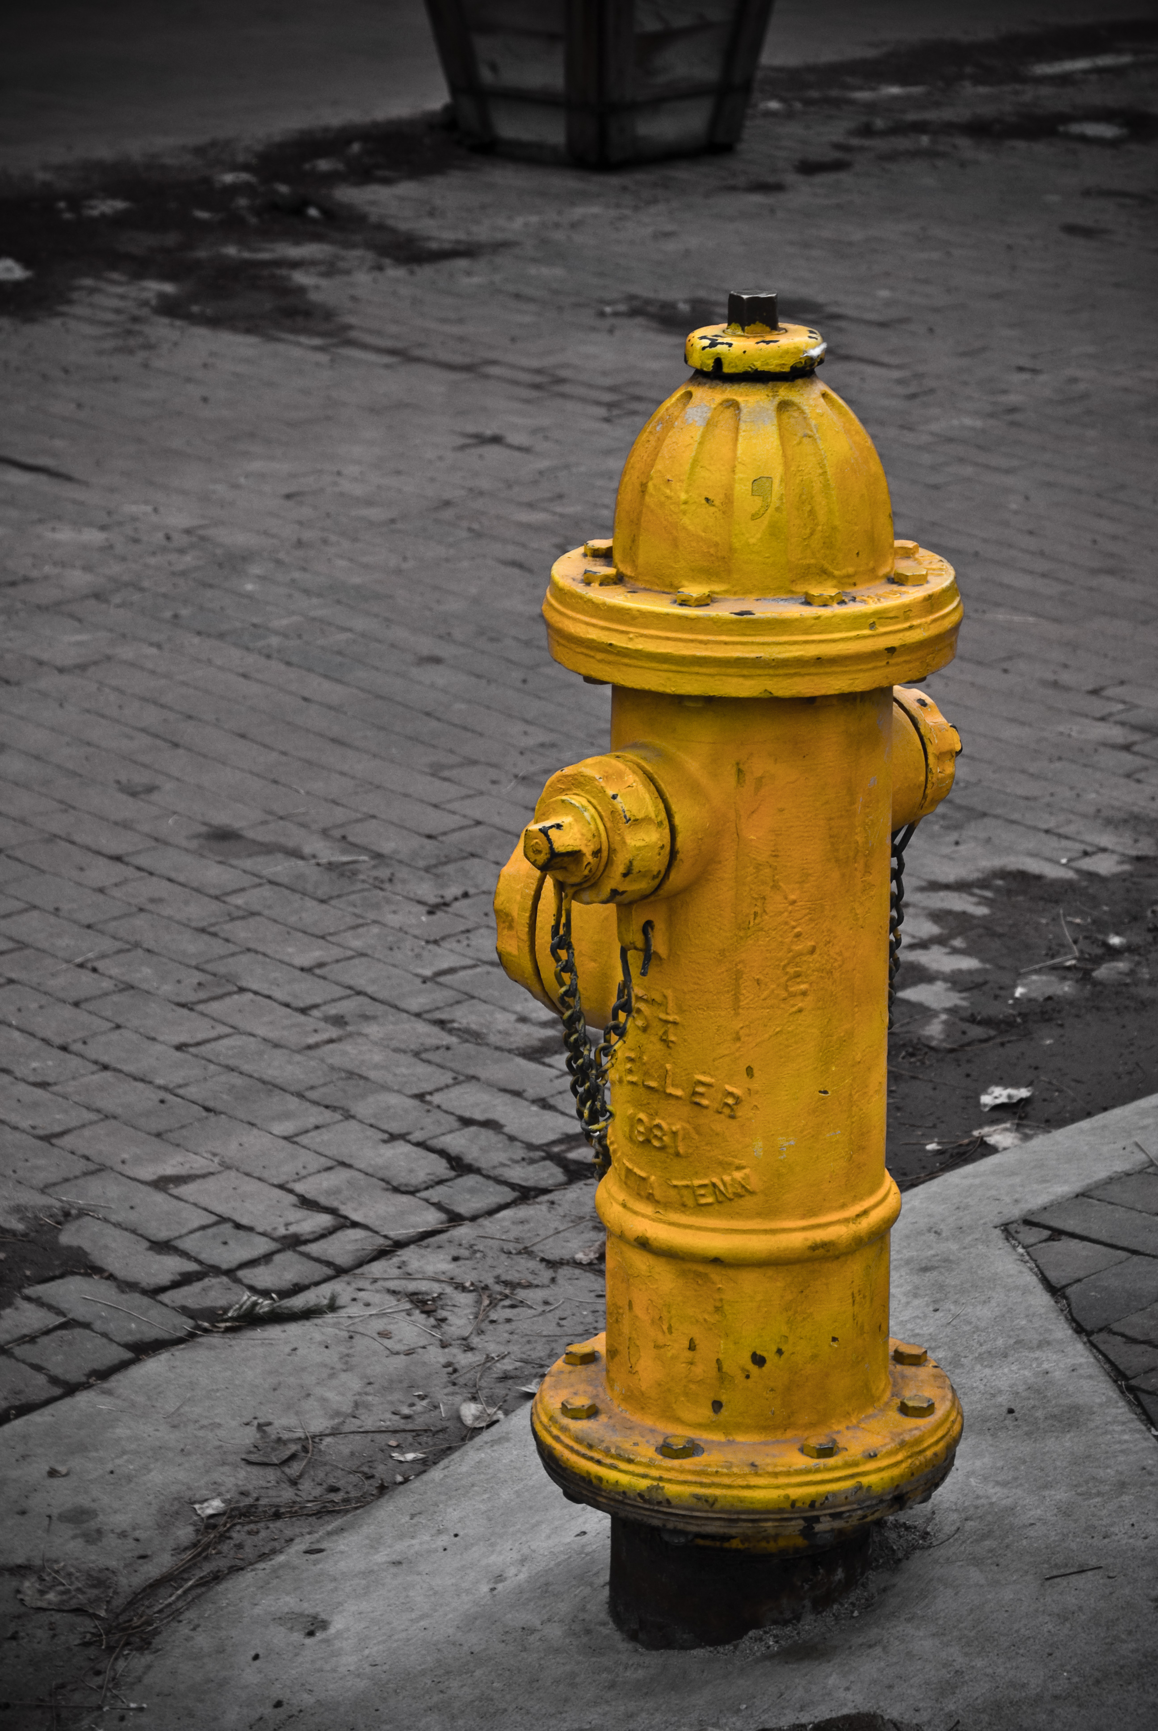
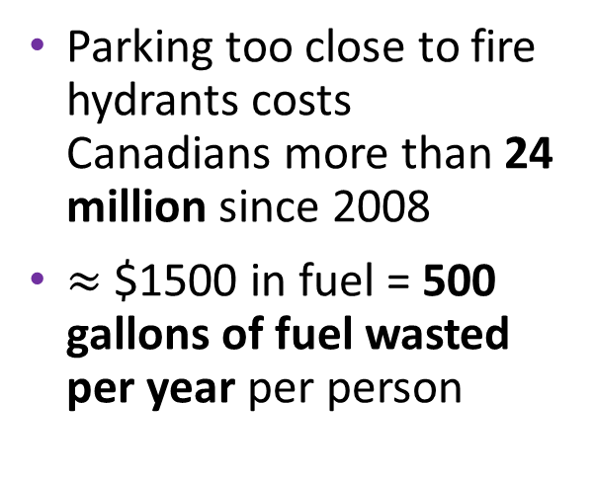
Significance
Parking
Public Health and
Safety
The average large city driver spends 107 hours per year looking for a spot
Totals to $2243 per year in wasted time and fuel per person, $80 million in fines
Canada Post spends just under $1 million a year on parking fines
Parking too close to fire hydrants costs Canadians more than 24 million since 2008
$≈$ $1500 in fuel = 500 gallons of fuel wasted per year per person
This Photo by Unknown Author is licensed under CC BY-SA
Sources: https://www.thestar.com/news/gta/2014/08/11/this_fire_hydrant_costs_toronto_drivers_the_most_in_parking_tickets.html
https://www.usatoday.com/story/money/2017/07/12/parking-pain-causes-financial-and-personal-strain/467637001/
Notes:
11.5 million people drive to work per day in Canada = 2.9 billion parking spots a year

Slide 5


Competition
Honk
Green P
Only registered HONK parking lots
User has to pre-select/select lot before entering
Does not lead user to destination only parking lot
Focus on payment for parking
Toronto only

Slide 6


Market
11.5 million people drive to work per day in Canada
2.9 billion parking spots a year
Projected growth of mobile app industry to 64 billion dollars in 2020

Slide 7
Solution
Vision
A fully integrated parking app that convey the following in real time:
Navigate directly to open parking spots
Display parking signs and compare rates
Direct user to intended destination after parking

Slide 8
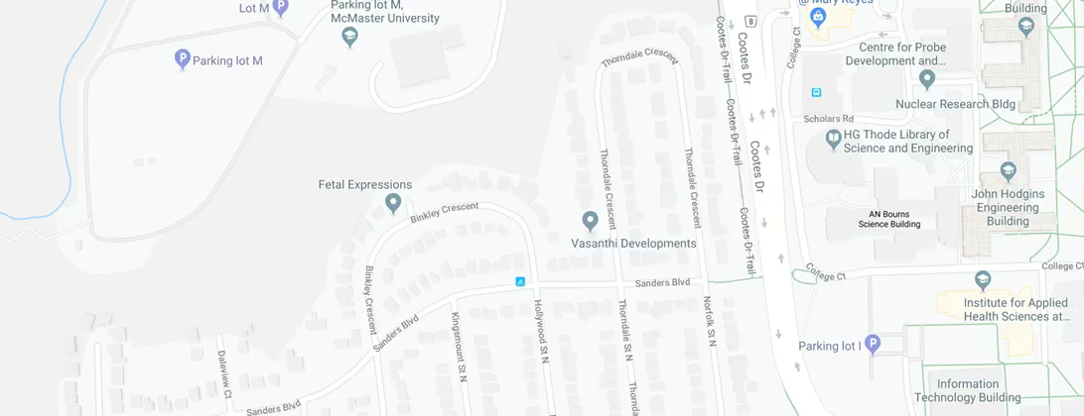
Demo

Slide 9

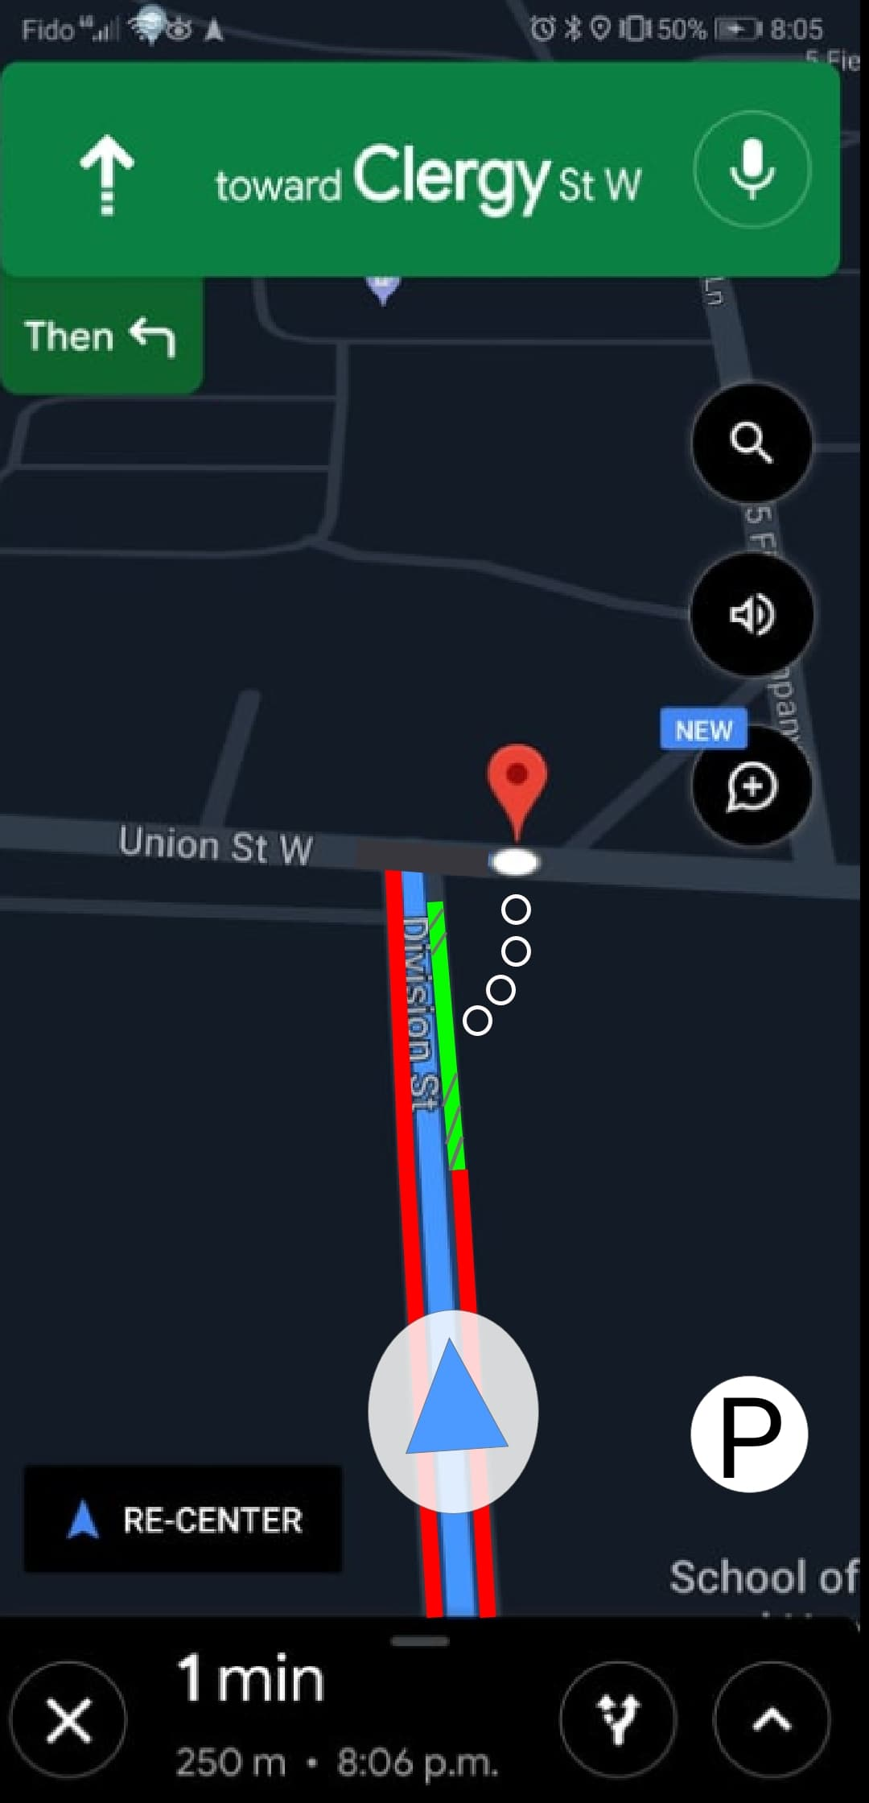
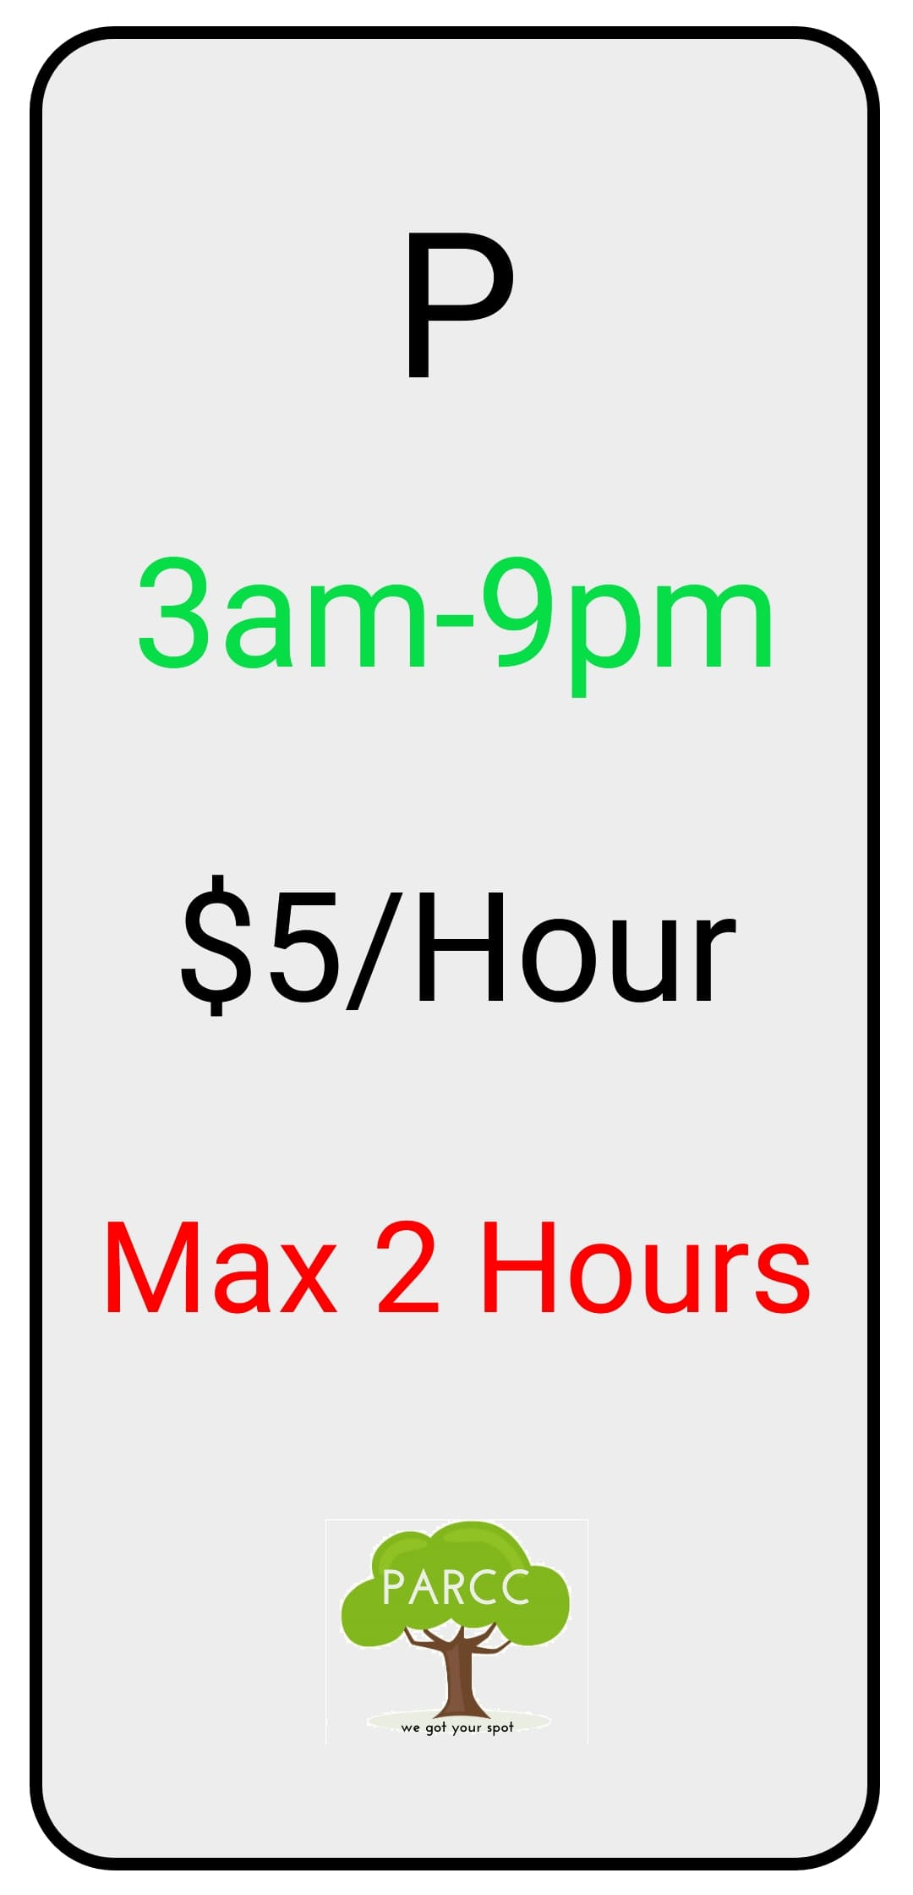
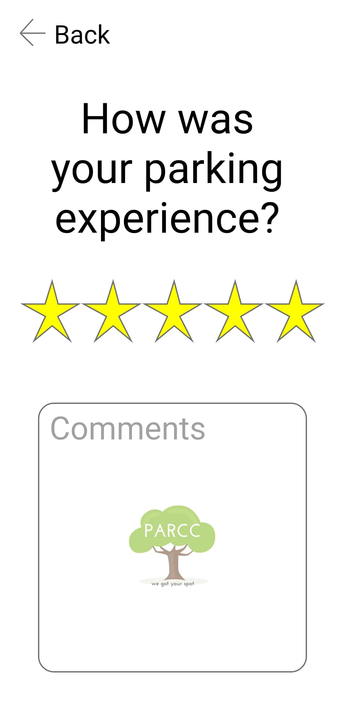
Demo

Slide 10
S t a c k

Slide 11
Questions?

Slide 12
Thank you!

